Slide 1
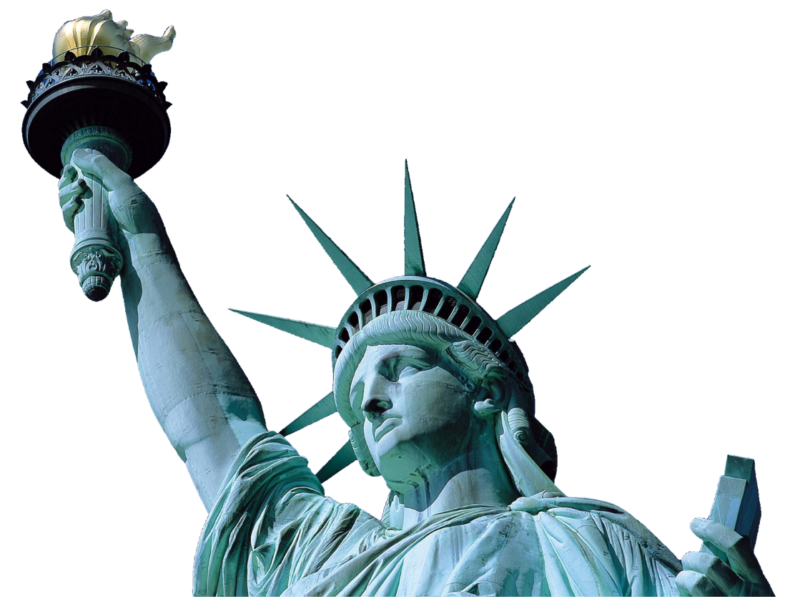
HOW TO GET INTO
A RESIDENCY
TRANING PROGRAM IN THE U.S.?
March 23th 2015
SPEAKERS : CHAYAWUT PUNSRIWONG AND CHAWISACHON NONSRI

Slide 2
PRE-TEST
0
0
5
4
3
2
1
0
0
9
8
7
6
5
4
3
2
1
0
9
8
7
6
5
4
3
2
1
0
9
8
7
6
5
4
3
2
1
0
9
8
7
6
5
4
3
2
1
0
9
8
7
6
5
4
3
2
1
0
9
8
7
6
5
4
3
2
1
0
0
5
0
4
Hours
Minutes
Seconds

Slide 3
Outline
Introduction
Main topics
ECFMG certificate
USMLE
ERAS
Interview
Matching
Discussion
Interesting statistics and data
USCE
Budgets
Conclusion
Q&A
Resource

Slide 4
Introduction

Slide 5
Life after graduation

Slide 6
Opportunities after graduation
Study
Work
Notes:
เรียนต่อ
สายแพทย์ (ในประเทศ, ต่างประเทศ)
ด้านอื่นๆ (ในประเทศ, ต่างประเทศ)
ทำงาน
สายแพทย์
ด้านอื่นๆ เช่น เอกชน, คลินิกเสริมความงาม, อาชีพอื่นๆ

Slide 7
WHY U.S.?

Slide 8
How many hours physician typically work each week?
2014 Work/Life Profiles of Today’s Physician

Slide 9
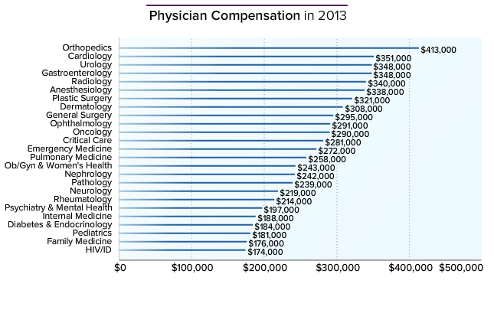
Salary?
Medscape Physician Compensation Report 2014

Slide 10
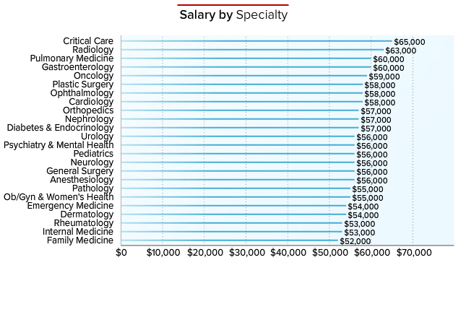
Residents salary
Medscape Residents Salary and Debt Report 2014
Notes:
Average $55,300

Slide 11
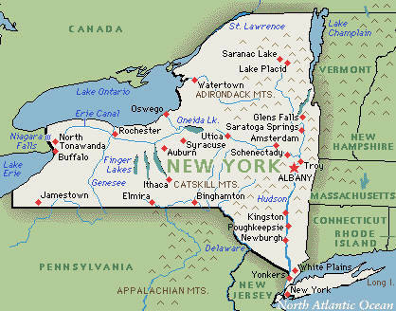
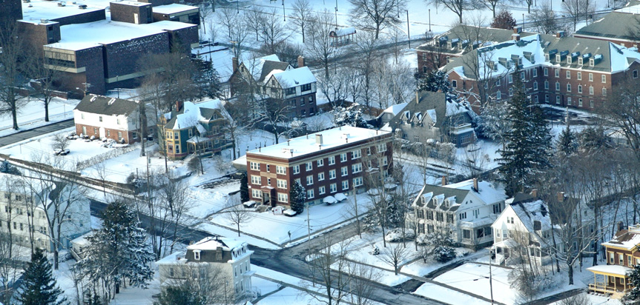
My experiences in U.S
Work and travel program – as a packer at Marietta Corporation Cortland, NY in 2011
Notes:
Social security number

Slide 12
Main topics
ECFMG Certificate
USMLE
ERAS
Interview
Matching

Slide 13
ECFMG Certification

Slide 14
ECFMG Certification
ACGME requires IMGs who enter ACGME-accredited programs to be ECFMG certified.
Requirement for US medical license
Just qualify that IMGs have met minimum standards of eligibility to enter program, not guarantee that these graduates will be accepted into program
ECFMG certification process by applying to ECFMG for a USMLE/ECFMG Identification Number. → Complete the application for ECFMG certification
Application fee → $65

Slide 16
Requirement for ECFMG certification
Medical Education Credential Requirements
Be a graduate of a medical school listed in the International Medical Education Directory (IMED).
IMG’s medical education credentials, including the final medical diploma, final medical school transcript, and transcript(s) to document transferred academic credits.
Examination requirement
USMLE Step 1, USMLE Step 2 CK and USMLE Step 2 CS
Notes:
International medical graduates must have been awarded credit for at least four credit years (academic years for which credit has been given toward completion of the medical curriculum) by a medical school that is listed in IMED.

Slide 17
In 2015, FAIMER’s IMED will be discontinued and the new World Directory of Medical Schools will replace IMED for the purpose of determining eligibility for examination and ECFMG Certification. International medical students and graduates should monitor the ECFMG website for information on the transition from IMED to the World Directory. Prior to this transition in 2015, international medical students/graduates should continue to consult IMED to determine whether their medical school meets the requirements for them to apply to ECFMG for examination and for ECFMG Certification.
Notes:
http://www.faimer.org/resources/imed.html

Slide 18
Medical Education Credential Requirements

Slide 19
Final medical diploma
Photocopy of Final medical diploma (Original and official English translation)
The exact name of diploma must listed in Reference Guide for Medical Education Credentials
Full faced, passport sized, color current photograph ( within 6 months)
Medical School Release Request (Form 345)
The name on your medical diploma must match exactly the name in your ECFMG record.
Notes:
The photocopies of your medical diploma must be 216 mm x 279 mm (8½ in x 11 in).
If these documents are larger than 216 mm x 279 mm (8½ in x 11 in),
you must send reduced photocopies that are 216 mm x 279 mm (8½ in x 11 in).

Slide 20
Final Medical Transcript
Photocopy of Final medical transcript (Original and official English translation)
The name on your final medical school transcript must match exactly the name in your ECFMG record.
Notes:
The photocopies of your medical school transcript must be 216 mm x 279 mm (8½ in x 11 in). If these documents are larger than 216 mm x 279 mm (8½ in x 11 in), you must send reduced photocopies that are 216 mm x 279 mm (8½ in x 11 in).

Slide 21
Transfer Credits
Credits must be transferred from one IMED-listed medical school to another IMED-listed medical school.
Credits must be for courses taken at one medical school within seven years of the date of graduation at the medical school that accepts the transferred courses.
Credits must be for courses that were passed at the medical school at which the course was taken.
Notes:
The criterion that credits must be transferred from one IMED-listed medical school to another IMED-listed medical school does not apply to credits transferred only to the pre-medical portion of the curriculum of the medical school that awarded or will award the medical degree. If you transferred credits to the pre-medical portion of the curriculum at the medical school that awarded or will award your medical degree from an institution that is not anIMED-listed medical school, you must provide ECFMG with a letter from the medical school that awarded or will award your medical degree confirming that the credits were transferred to the pre-medical portion of the curriculum only. This letter must be on the letterhead of the medical school and be signed by an authorized official of your medical school. This letter must be submitted in conjunction with the application for examination and must accompany the Certification of Identification Form (Form 186) or Certification Statement (Form 183). Applications received without this letter may be rejected. This letter is in addition to disclosing and documenting all transferred credits as described above.

Slide 22
Transcript(s) to Document Transferred Credits
Photocopy of an official transcript issued by the school or institution at which the course was taken. (Original and official English translation)
The name on your transcript(s) to document transferred credits must match exactly the name in your ECFMG record
Notes:
Transcript(s) to Document Transferred Credits

Slide 23
Main topics
ECFMG Certificate
USMLE
ERAS
Interview
Matching

Slide 24
Examination requirement

Slide 25
The United States Medical Licensing Examination (USMLE)
The USMLE is a three-step examination for medical licensure in the United States consisting of
Step1 → Basic Sciences ( NL part1)
Step2 → apply medical knowledge, skills, and understanding of clinical science essential for the provision of patient care under supervision
Step 2 CK → MCQ ( NL part2)
Step 2 CS → Clinical assessment
Step3 → assesses the examinee’s understanding of biomedical and clinical sciences essential for the unsupervised practice of medicine

Slide 27
Registration and applying examination
Get the ECFMG/USMLE number
Complete the ECFMG application through IWA
Complete the required document and sent to ECFMG by medical school
Verifying documents by ECFMG
Check the information and financial status by using OASIS

Slide 28
Eligibility for Examination
Medical school student
Studying in medical school that listed in IMED
Complete at least 2 years of medical school ( basic medical science components)
Studying in clinical year or complete clinical clerkship is recommended for step2CK and CS
Medical school graduates

Slide 29
Time Limit for Completing Examination Requirements
ECFMG policy requires that international medical students/graduates pass the USMLE Steps and Step Components required for ECFMG Certification within a seven-year period.
May complete all steps by any sequences

Slide 30
Time Limit for Completing Examination Requirements (Cont.)
Example
Dr.A
USMLE Step2CS: January 15th 2015
USMLE Step1 : April 17th 2015
So Dr.A have to finish the USMLE Step2CK within January 15th 2022

Slide 31
Number of attempts and retaking
The USMLE program limits to six the total number of times an examinee can take the same Step or Step Component. A
You may not take the same examination more than three times within a 12-month period. Your fourth and subsequent attempts must be at least 12 months after your first attempt at that examination and at least six months after your most recent attempt at that examination.

Slide 32
United States Medical Licensing Examination (USMLE)

Slide 33
USMLE Step1
322 multiple-choice items divided into 7 blocks of 46 items; 60 minutes are allotted for completion of each block of test items.
Takes 8 hours
Computer based at prometric center (Maneeya Center, Bangkok)
Minimum passing score is 192
Examination fee → $865 + $150 (international surcharge)

Slide 34
Step 1 table of specifications

Slide 35
Test Question Formats
Single-item questions
Sequential item sets
Example

Slide 36
USMLE Step2 CK
The number of question will vary among blocks, but will not exceed 45 items. The total number of items on the overall examination form will not exceed 355 items.
60 minutes are allotted for the completion of each block.
Computer based at prometric center (Maneeya Center, Bangkok)
Minimum passing score is 209
Examination fee → $865 + $165 (international surcharge)

Slide 37
Step2 CK table of specifications

Slide 38
Step 2 CK Physician Task/Competency Specifications

Slide 39
Test Question Formats
Single-item questions
Sequential item sets
Matching sets
Example

Slide 40
Step2 CS
Uses standardized patients to test medical graduates
Clinical skills
Communication skills
12 cases: Fifteen minutes for each patient encounter + ten minutes to record each patient note (PN)
Test centers available in the U.S. only
Atlanta, Chicago, Houston, Los Angeles, and Philadelphia
Examination fee → $1,505

Slide 41
Examination Format
On-site orientation
The Patient Encounter (15 minutes for each)
Standardized patients
Telephone patient encounter
The Patient note (Computer typing)
10 minutes to complete ( additional time if leaving the patient encounter early)
Medical record include medical history, PE, DDx,
diagnostic studies, treatment, consultations
Example

Slide 42
Scoring the USMLE step2 CS
Scoring as pass or fail
3 subcomponents
Communication and interpersonal skills
Spoken English proficiency
Integrated clinical encounter

Slide 43
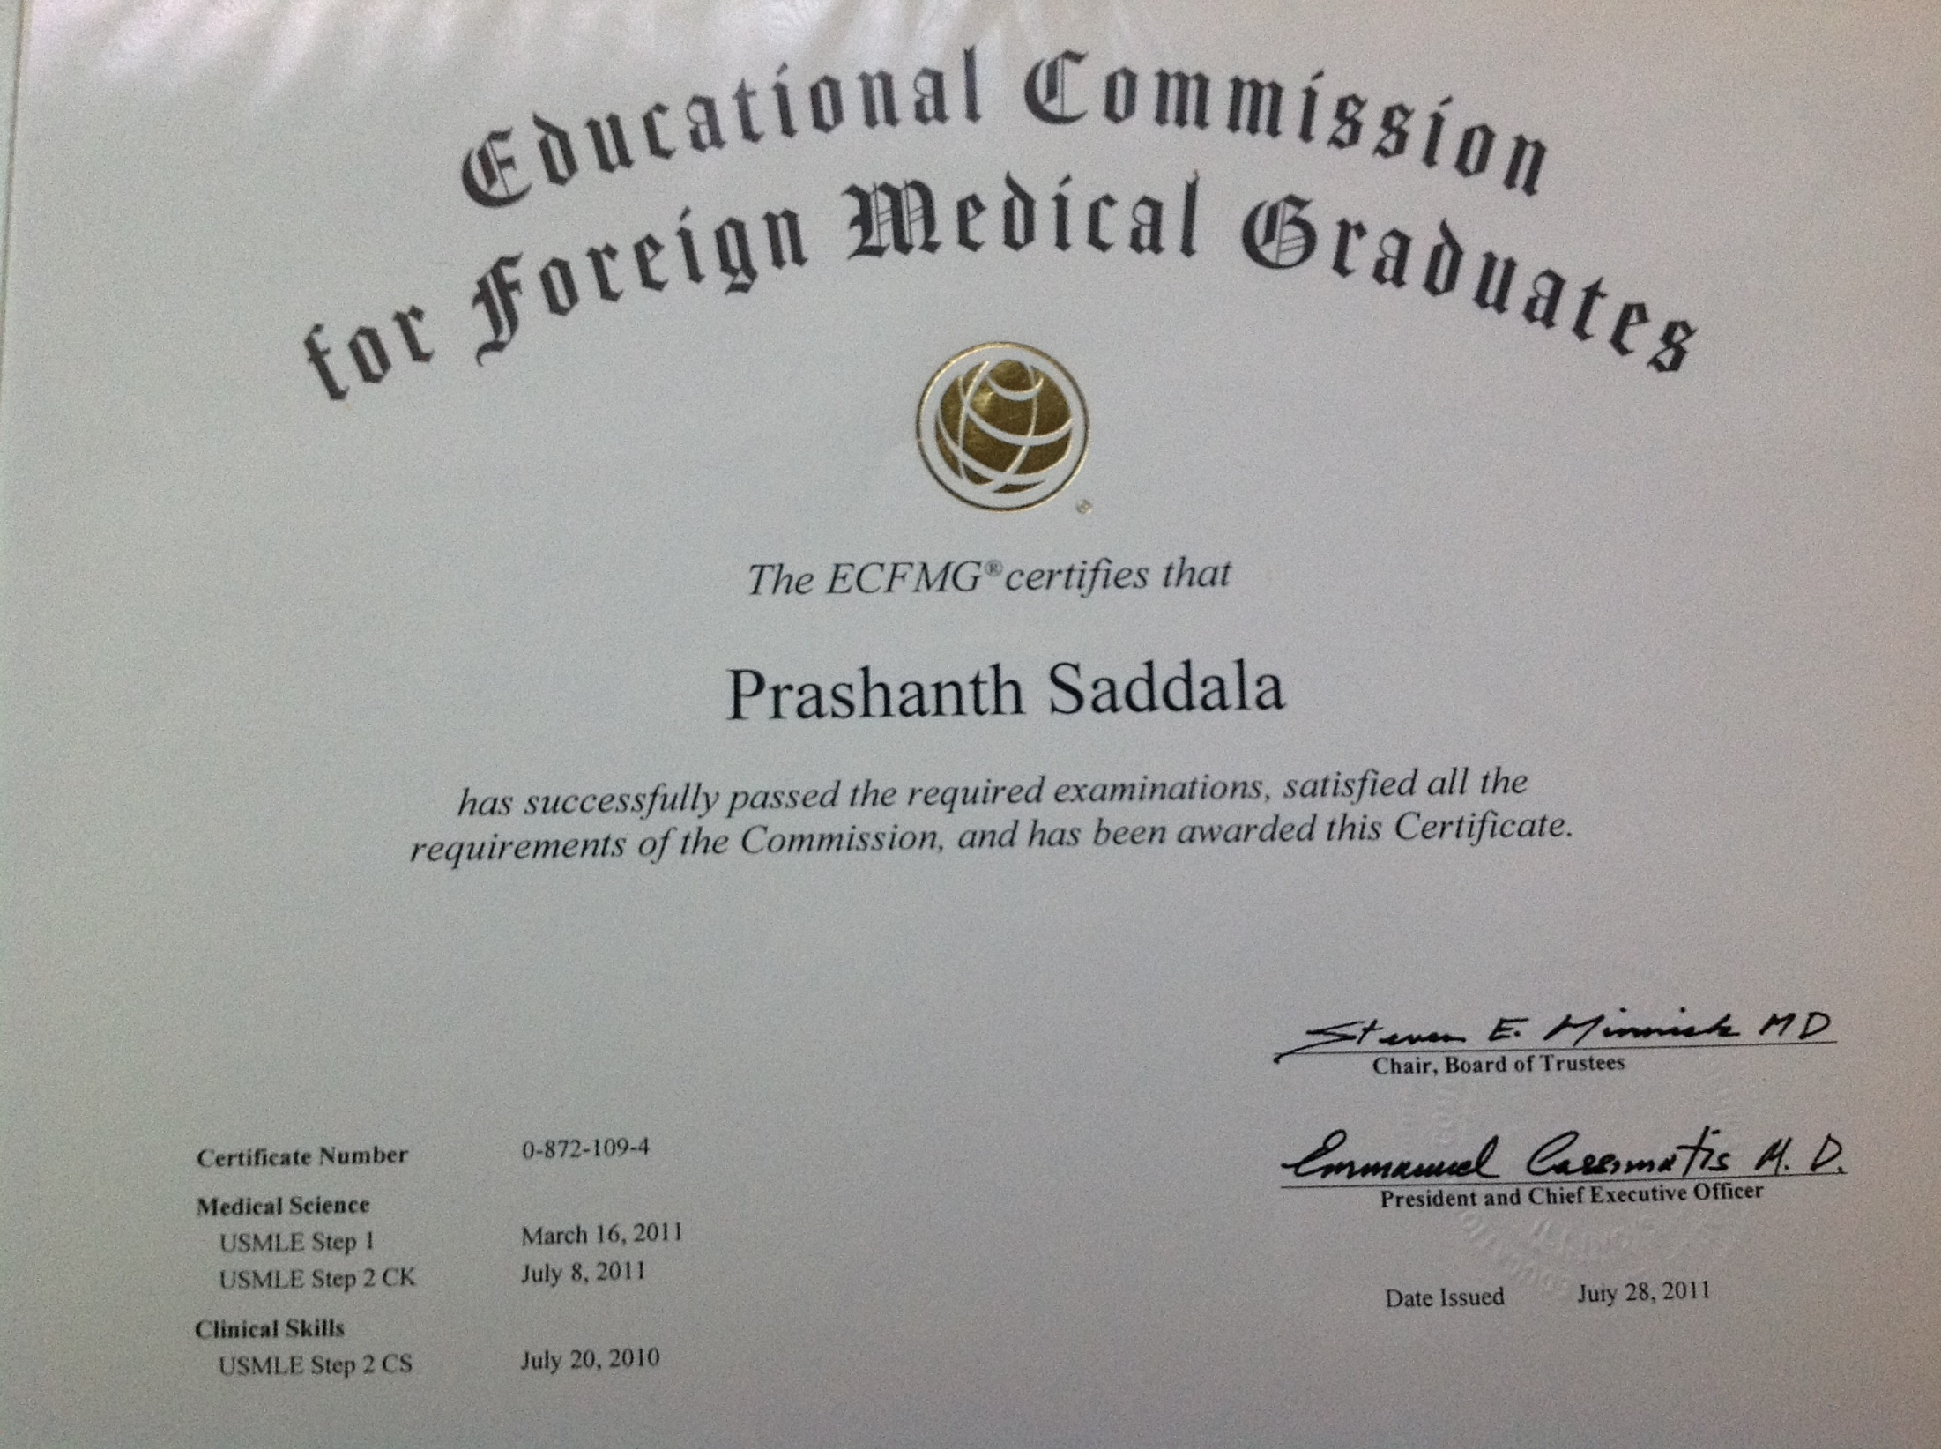

Slide 44
Main topics
ECFMG Certificate
USMLE
ERAS
Interview
Matching

Slide 45
Electronic Residency Application Service (ERAS)

Slide 46
What is ERAS?
ERAS® is a service that transmits the MyERAS application and supporting documentation from applicants and program directors.
The usefulness of MyERAS application is to
Manage documents,
Apply to programs

Slide 47
Use MyERAS to
Create your Profile
Complete and certify your on-line application
Create Personal Statements
Select and apply to your preferred programs
Create and manage your ERAS application and document assignments for all of your programs
Track the status of your ERAS application via the Applicant Document Tracking System (ADTS)
Utilize the MyERAS message center to contact ERAS Support Services at ECFMG
Notes:
ขอรับ ERAS token จาก OASIS

Slide 48
Step in the ERAS process
http://www.docstoc.com/docs/82389627/ERAS-Application-Process-Guideline---Home-Page-Department-of
Notes:
ขอรับ ERAS token จาก OASIS

Slide 49
What you have to complete in ERAS?
Your profile
Supporting documents

Slide 50
Profile
First, Middle, and Last Name
Previous Last Name
Preferred Name
Suffix
MyERAS Contact Email
AAMC aacount Email
Present Mailing Address
Preferred Phone Number
Alternate Phone Number
Fax/Pager/Mobile Number
Last 4 digits of SSN (This is not a required field)
Citizenship Status
Current Visa Status/Expected Visa Type/Visa Sponsership
Notes:
ขอรับ ERAS token จาก OASIS

Slide 51
Supporting Documents
Personal statement
Medical Student Performance Evaluation (MSPE)
Medical School Transcript
Letters of Recommendation (LoRs)
Photograph (optional)
ECFMG Status Report (IMG only)
USMLE Transcript (optional)
Postgraduate Training Authorization Letter (PTAL) or “California Letter” (IMG only)
Notes:
ขอรับ ERAS token จาก OASIS

Slide 52
Program 1
Program 2
Program 3
Program 4

Slide 53
ERAS
https://services.aamc.org/eras/myeras2015/
Notes:
Register MyERAS website

Slide 54
Program selection
Types of program participate in the main residency match
Categorical: program that begin in the PGY-1 year and provide full training required for specialty board certification.
Advanced: Programs that begin in PGY-2 year after a year or prerequisite training for advanced program.
Preliminary: One-year program that begin in PGY-1 year and provide prerequisite to advanced program

Slide 55
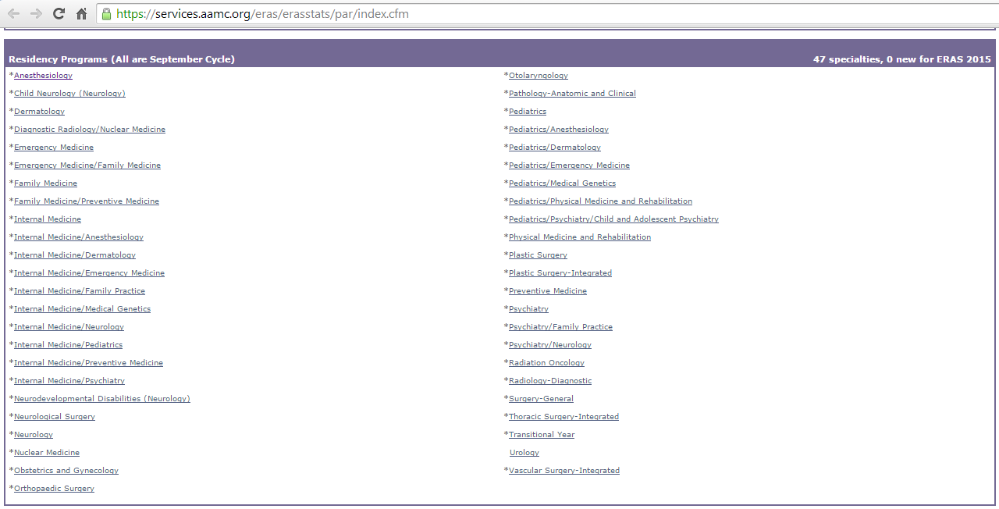
ERAS
Selecting a Residency Program : Searching program
https://services.aamc.org/eras/erasstats/par/index.cfm
Notes:
For more information about specialties and programs that participate in ERAS, refer to the ERAS 2015 Participating Specialties and Programs on the AAMC website.

Slide 56
ERAS
Selecting a Residency Program : Searching
https://login.ama-assn.org/account/login
Notes:
The American Medical Association (AMA) also provides a free on-line Residency/Fellowship Training Program Search through FREIDA Online®.

Slide 57
ERAS application fee
Programs Per Specialty | Application Fees
Up to 10 | $95
11-20 | $10 each
21-30 | $16 each
31 or more | $26 each
Example 1
30 Emergency Medicine programs [$95 + (10 x $10) + (10 x $16)] = $355
Example 2
23 Internal Medicine programs [$95 + (10 x $10) + (3 x $16)] + 7 Radiology programs [$95] = $338

Slide 58
Main topics
ECFMG Certificate
USMLE
ERAS
Interview
Matching

Slide 59
Interview

Slide 60
Interview
Example questions
Tell me about yourself.
Why are you pursuing <specialty>?
Where do you see yourself in 6-7 years?
What are your greatest strengths?
Tell me about your weakness.
Why should we choose you over other applicants?
What interests do you have outside of medicine?
What question do you have for me?

Slide 61
Interview
Example
Example1

Slide 62
Main topics
ECFMG Certificate
USMLE
ERAS
Interview
Matching

Slide 63
Matching

Slide 64
Timeline
http://www.residencysecrets.com/wp-content/uploads/2013/11/Residency-Roadmap.jpg

Slide 65
Ranking and Matching Process
Apply to programs
Interview
Rank order list → applicants rank the programs, programs rank the applicants
Match!
Tentative method
Example

Slide 66
Examples
Dr. A rank order list
Harvard Medical school
Tuft University, Boston
University of Hawaii
Mayo clinic
Cleveland clinic
NYU
Harvard Medical school rank order list
Dr. A
Dr. B
Dr. C
Dr. B

Slide 67
Match Result
Congratulations, you have matched!
matched to a categorical or primary program.
matched to a PGY-1 preliminary and PGY-2 advanced program.
Congratulations, you have matched to an advanced position!
SOAP for PGY-1 position (if needed)
Congratulations, you have matched to a one year position!
SOAP for advanced position (if needed)
We are sorry, you did not match to any position!

Slide 68
Match fee
Participant Type | Fee
U.S. Seniors/Non U.S. Seniors | $65
Late Registration Fee | $50 additional
Couples | $15 additional per partner
Additional programs ranked | $30 additional per program
Institution registration fee | $210
Program registration fee | $40
Per applicant matched to program | $40

Slide 69
Supplement Offer and Acceptance Program (SOAP)
Eligible unmatched applicants apply to participating unfilled programs.
Almost unfilled positions are for US graduates

Slide 70
Discussion

Slide 71
Interesting statistics and data

Slide 72
Notes:
กราฟแสดงจำนวนผู้เข้าสมัครและตำแหน่งที่รับได้ >>> ผู้สมัครมีจำนวนเพิ่มมากขึ้นกว่าตำแหน่งที่มีอยู่ >>> การแข่งขันค่อนข้างสูง

Slide 73
Applicant types
U.S. Senior
U.S. Graduates
Osteopathic Graduates
Canadian
5thpathway
U.S. IMG
Non-U.S. IMG

Slide 74
Notes:
กราฟแสดงจำนวนผู้เข้าสมัครแยกตามประเภทของ applicants >>> non US IMG มีจำนวนเยอะ เกือบ 25%

Slide 75
Positions per All Active and Active U.S. Senior Applicant, 1976 - 2014
Results and Data 2014 Main Residency Match®

Slide 76
Match Rate by applicant type
Results and Data 2014 Main Residency Match
Notes:
Results and Data 2014 Main Residency Match

Slide 77
Notes:
กราฟแสดงตำแหน่งที่รับได้ และจำนวนที่ถูก filled ด้วย allopathic seniors ที่เหลือจะเป็นตำแหน่งของ applicants กลุ่มอื่นๆ

Slide 78
Notes:
กราฟแสดง %matched แยกตาม specialty and applicant type

Slide 79
Matching Statistic

Slide 81
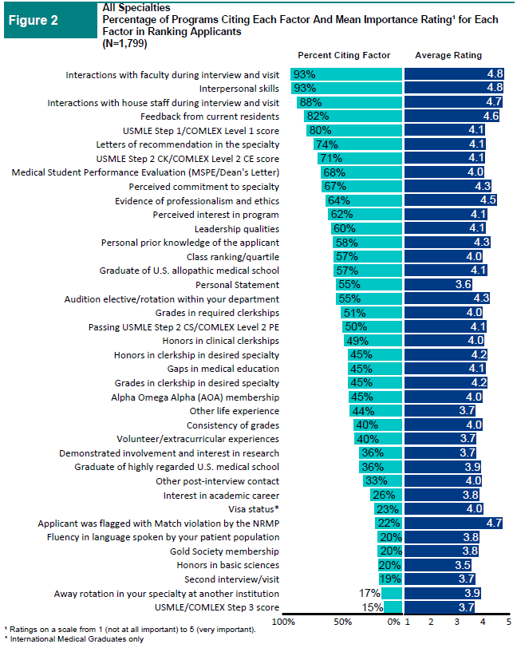

Slide 82
IMG applicants who are successful in matching to their preferred specialty are more likely to:
Have higher USMLE scores
Have fewer attempts at ECFMG certification examinations
Rank more programs within their preferred specialty
Speak English as a native language
Have obtained ECFMG certificate closer to the Match year
Have graduated from medical school closer to the Match year
Be U.S. citizens
NRMP and ECFMG Charting Outcomes in the Match for International Medical Graduates Revised

Slide 83
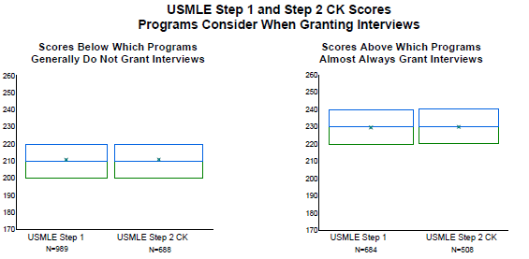

Slide 86
IMG applicants who are successful in matching to their preferred specialty are more likely to:
Have higher USMLE scores
Have fewer attempts at ECFMG certification examinations
Rank more programs within their preferred specialty
Speak English as a native language
Have obtained ECFMG certificate closer to the Match year
Have graduated from medical school closer to the Match year
Be U.S. citizens
NRMP and ECFMG Charting Outcomes in the Match for International Medical Graduates Revised

Slide 89
IMG applicants who are successful in matching to their preferred specialty are more likely to:
Have higher USMLE scores
Have fewer attempts at ECFMG certification examinations
Rank more programs within their preferred specialty
Speak English as a native language
Have obtained ECFMG certificate closer to the Match year
Have graduated from medical school closer to the Match year
Be U.S. citizens
NRMP and ECFMG Charting Outcomes in the Match for International Medical Graduates Revised

Slide 91
IMG applicants who are successful in matching to their preferred specialty are more likely to:
Have higher USMLE scores
Have fewer attempts at ECFMG certification examinations
Rank more programs within their preferred specialty
Speak English as a native language
Have obtained ECFMG certificate closer to the Match year
Have graduated from medical school closer to the Match year
Be U.S. citizens
NRMP and ECFMG Charting Outcomes in the Match for International Medical Graduates Revised

Slide 92
United States Clinical Experiences (USCE)

Slide 93
What is USCE?
USCE is stand for United States Clinical Experiences
Having USCE is to claim that you’ve already known US hospital based working experiences
Many programs require USCE
Optional, but improving chance for matching
Notes:
Even there is no statistic data support!

Slide 94
Types of USCE
Hands on Clinical experience
Clinical elective
Externship
Non-hands on clinical experience
Observership
Research elective

Slide 95
Pros and Cons
Pros
Find out that you really like it (US style)
Improve credential
Having more programs to rank
English communication skill
Cons
Expensive
It’s not 100% guarantee that you will get in the program.
Notes:
Improve credential
- Making contact with professor in the program → greatest point to have LORs

Slide 96
Clinical elective
There is no specific organization to provide the medical school.
It usually takes 4 weeks per rotation.
Two ways to find clinical elective programs
Medical school affiliate
Self contact

Slide 97
Requirement
Studying in Final year medical school
USMLE step1
English proficiency test
Some not require anything, you just have enough money!

Slide 98
What about NU?

Slide 99
My list
Harvard Medical School
Tulane University School of Medicine
Tufts University School of Medicine
University of Massachusetts Medical School
Johns Hopkins School of Medicine (Research elective only)

Slide 100
Budgets

Slide 101
Budgets
Fixed costs
Application for ECFMG Certification $65
Examination
USMLE step 1 $865 + $150
USMLE step 2 CK $865 + $165
USMLE step 2 CS $1,505
ERAS support Services
ERAS token $105
Electronic transmission of USMLE transcript for ERAS $75
First 10 programs application fee $95
Application for J1 VISA $160
Verification to state Medical Licensing Authority $35
Match fee &65
$4,150
Notes:
ค่าธรรมเนียมยื่นคำร้องขอ VISA $160
SEVIS FEE (ค่าธรรมเนียมสำหรับดำเนินโครงการ Student and Exchange Visitor Program (SEVP) ) $200
Verification to state Medical Licensing Authority ใช้บอก status ของ ECFMG certification $35

Slide 102
Budgets
Variable costs
ERAS application
Example 1
30 Emergency Medicine programs [$95 + (10 x $10) + (10 x $16)] = $355
Example 2
23 Internal Medicine programs [$95 + (10 x $10) + (3 x $16)] + 7 Radiology programs [$95] = $338
Programs Per Specialty | Application Fees
Up to 10 | $95
11-20 | $10 each
21-30 | $16 each
31 or more | $26 each

Slide 103
Budgets
Variable costs
Match Fee
MAIN RESIDENCY MATCH
Participant Type | Fee
U.S. Seniors/Non U.S. Seniors | $65
Late Registration Fee | $50 additional
Couples | $15 additional per partner
Additional programs ranked | $30 additional per program
Institution registration fee | $210
Program registration fee | $40
Per applicant matched to program | $40

Slide 104
Budgets
Variable costs
Air fare
Hotel
Food
Travel and shopping
Notes:
ค่าธรรมเนียมยื่นคำร้องขอ VISA $160
SEVIS FEE (ค่าธรรมเนียมสำหรับดำเนินโครงการ Student and Exchange Visitor Program (SEVP) ) $200

Slide 105
Conclusion

Slide 106
Main steps
ECFMG Certificate
USMLE
ERAS
Interview
Matching

Slide 107
Suggestion
Set the goal early if you really want it!
Study hard (especially in your interesting program)
Keep practicing English
Looking for opportunities to USCE

Slide 110
Resource
Educational Commission for Foreign Medical Graduates (ECFMG)
www.ecfmg.org
United State Medical Licensing Examination (USMLE)
www.usmle.org
Electronic Residency Application Service (ERAS)
www.aamc.org/services/eras
The Match: National Resident Matching Program (NRMP)
www.nrmp.org

Slide 111
POST-TEST
0
0
5
4
3
2
1
0
0
9
8
7
6
5
4
3
2
1
0
9
8
7
6
5
4
3
2
1
0
9
8
7
6
5
4
3
2
1
0
9
8
7
6
5
4
3
2
1
0
9
8
7
6
5
4
3
2
1
0
9
8
7
6
5
4
3
2
1
0
0
5
0
4
Hours
Minutes
Seconds

